Slide 1
Two Offices – One Startup Challenges and Benefits
Nitzan Yudan

Slide 2
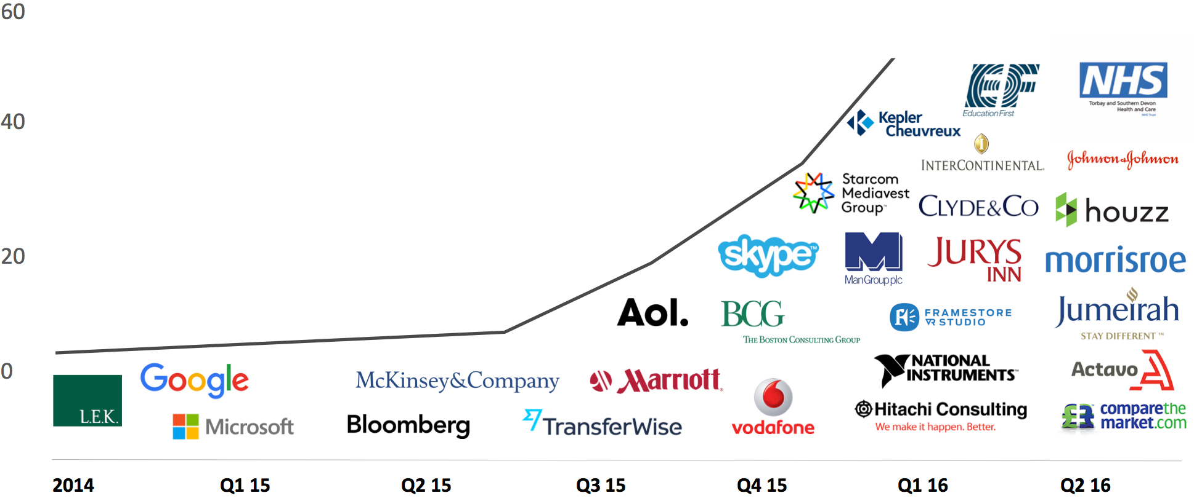
Moving Support to Junior Employees

Slide 3
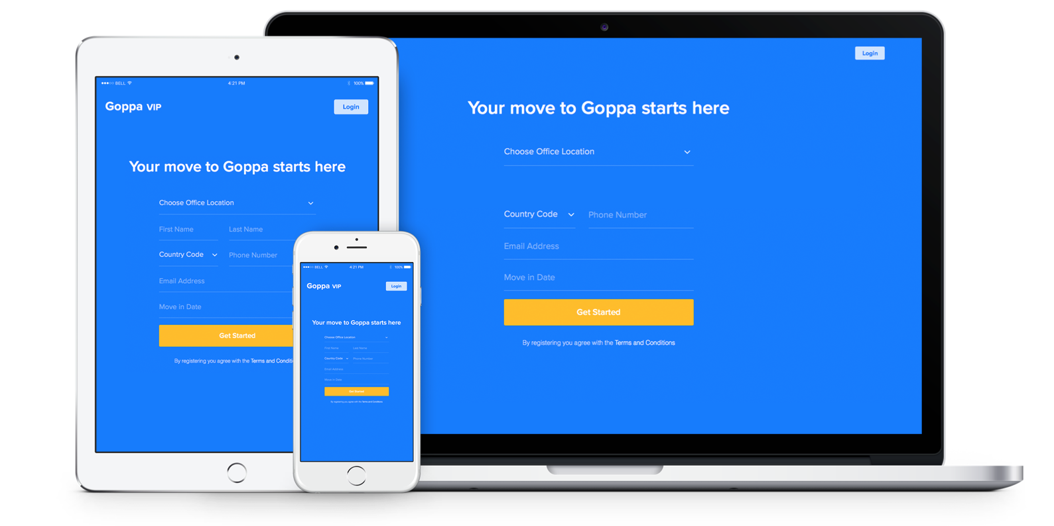
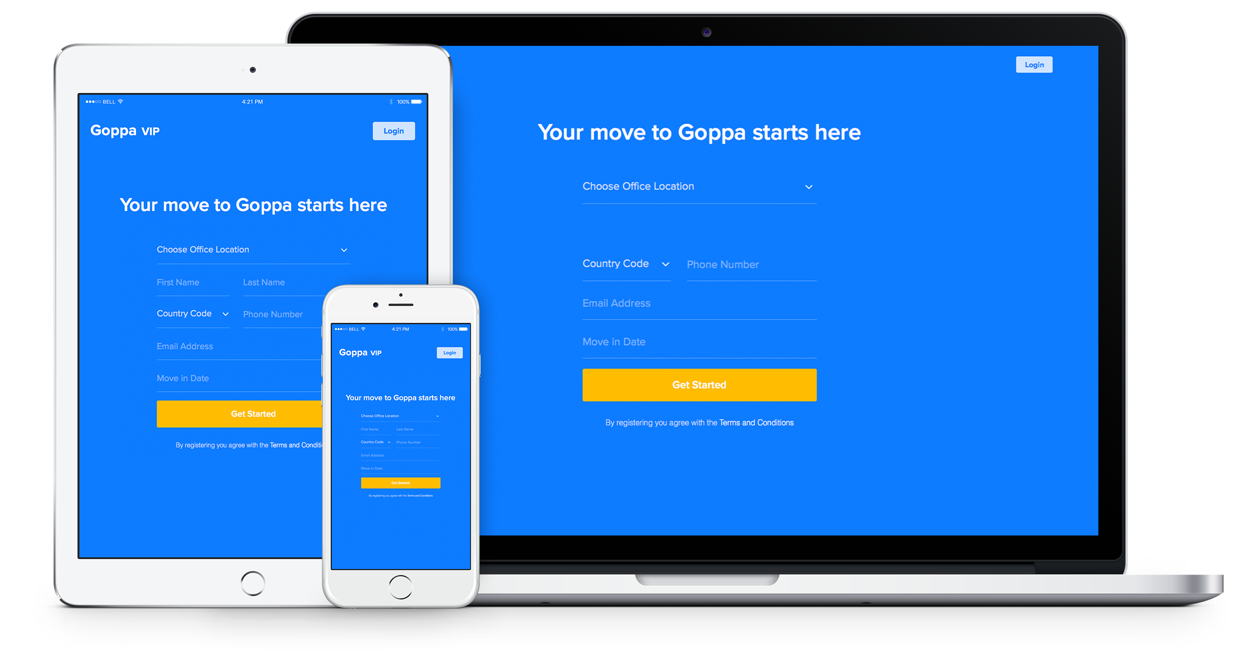
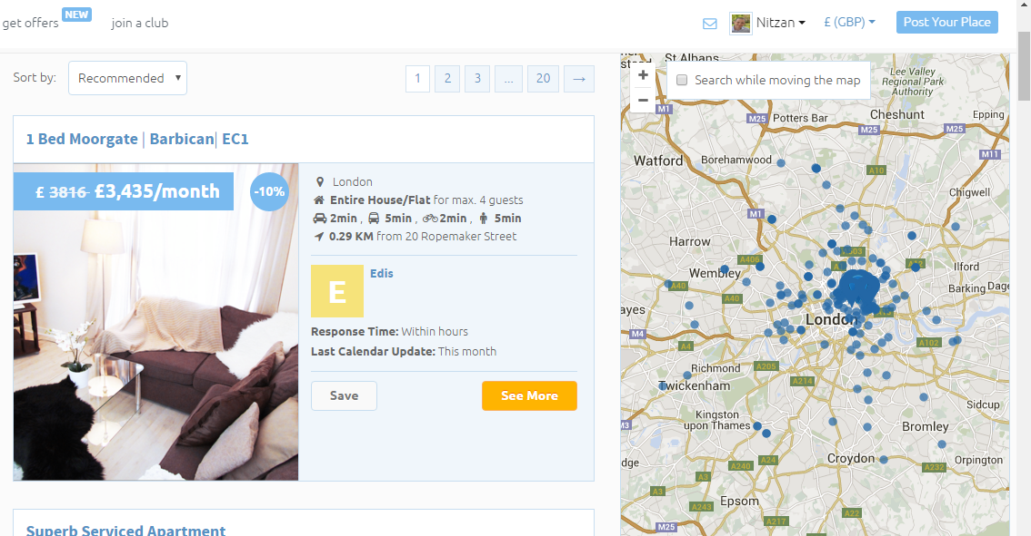

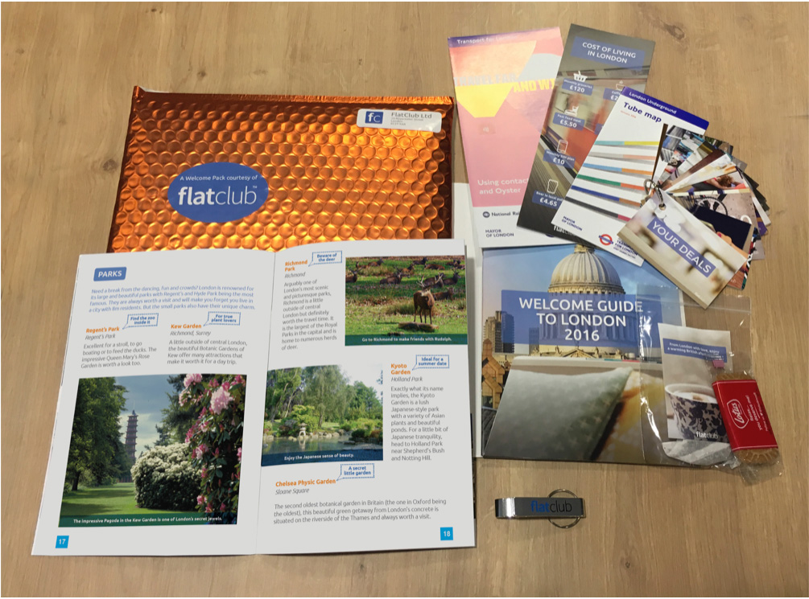
One stop shop technology solution for all employees & HR needs

Slide 4





Location, Location, Location

Slide 5
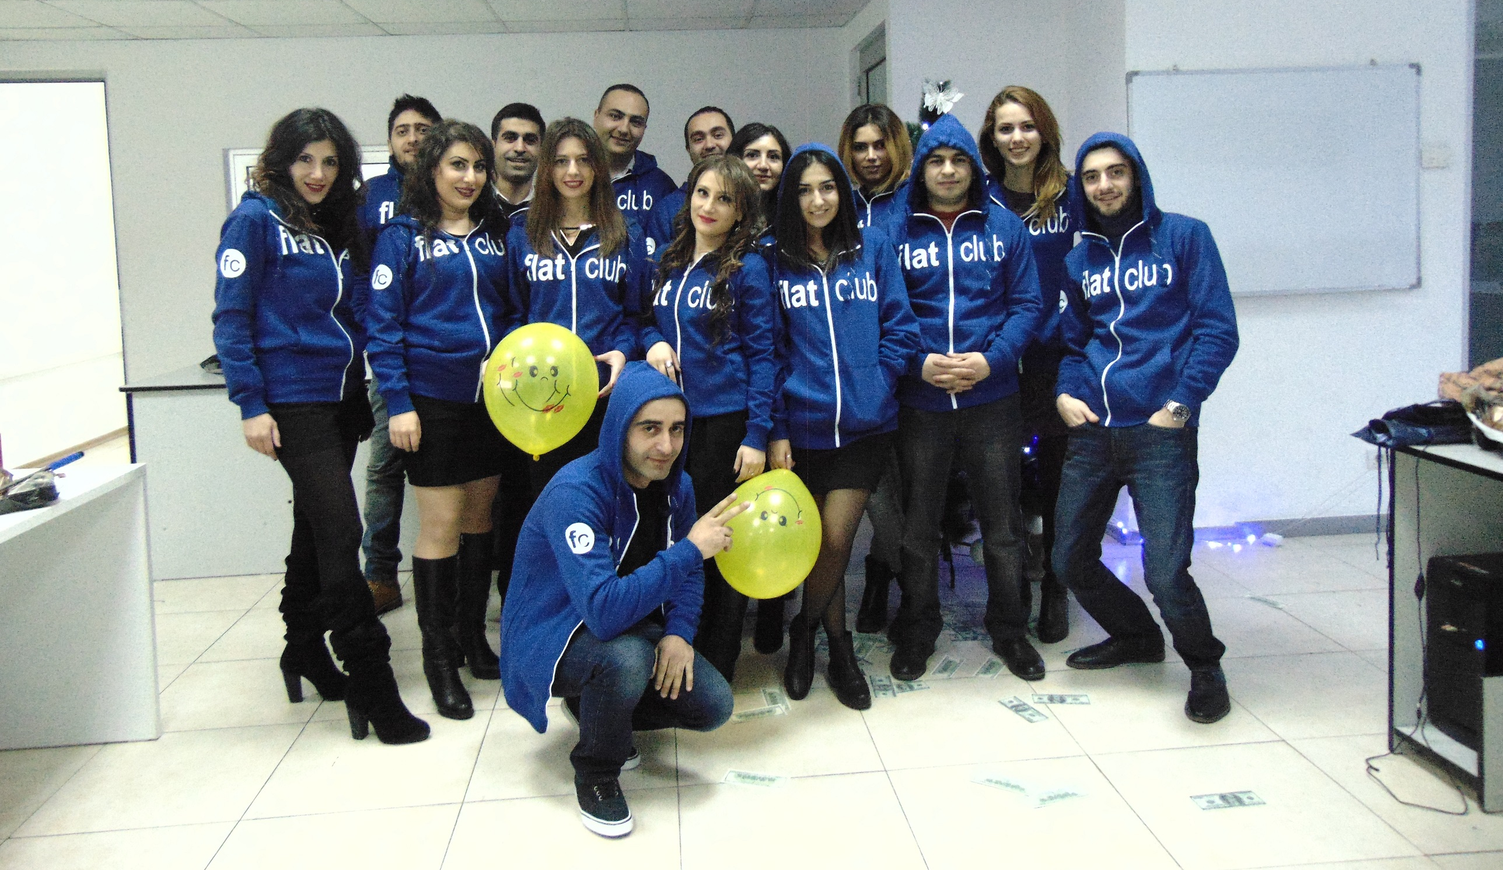

Slide 6
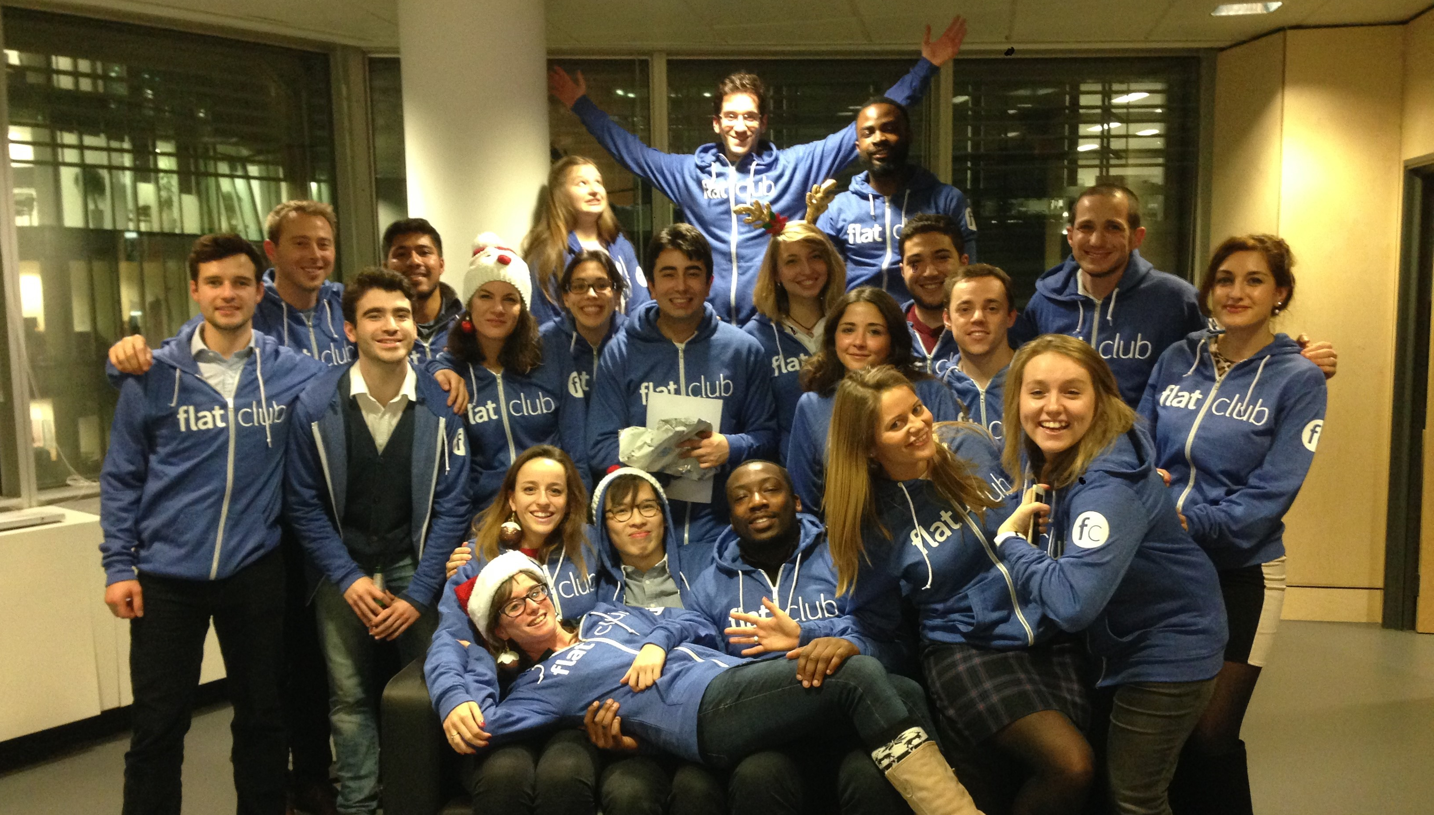

Slide 7
Thank You!
Nitzan Yudan
nitzan@flatclub.com
07516-259328

